Slide 1


VA|CMS User Roles
& Wireframes
March 27th, 2018
Submitted to
Office of Construction & Facilities Management
By
MAX.gov, Mitchell Jarrett

Slide 2
Personas

Slide 3

VA|CMS Personas
John Q. Public
1.
As a Public User, I want to browse the application for information that is currently available on the TIL and some that has not been available until now.
VA Planners
2.
As a VA Planner, I want to use the VA-CMS application during the planning phase of projects to define planning requirements.
Architectural & Engineering Firms
3.
As an Architecture and/or Engineering Firm, I want to use the application during the design phase to find specific requirements for each room.
Facilities Engineers
4.
As a Facilities Engineer, I want to use the application during the operational phase to find the right specifications for equipment, gases, et. al.

Slide 4
VA|CMS Personas
VA CFM Subject Matter Experts
5.
As a Subject Matter Expert, I want to add or update data to the database. They will also need to approve data entered by other users, e.g. Architectural and Engineering Firms.
Publisher
6.
As a Publisher, I want to review and publish data changes to the database as well as update documents in the TIL.
Software Developer
7.
As a developer, I would like to access the VA-CMS database to power an application I am designing.
Administrator
8.
As an application Administrator, I want to manage who has access to the application (beyond that of a public user) and who can add, edit or delete information from the Database and TIL.

Slide 5
User Roles

Slide 6
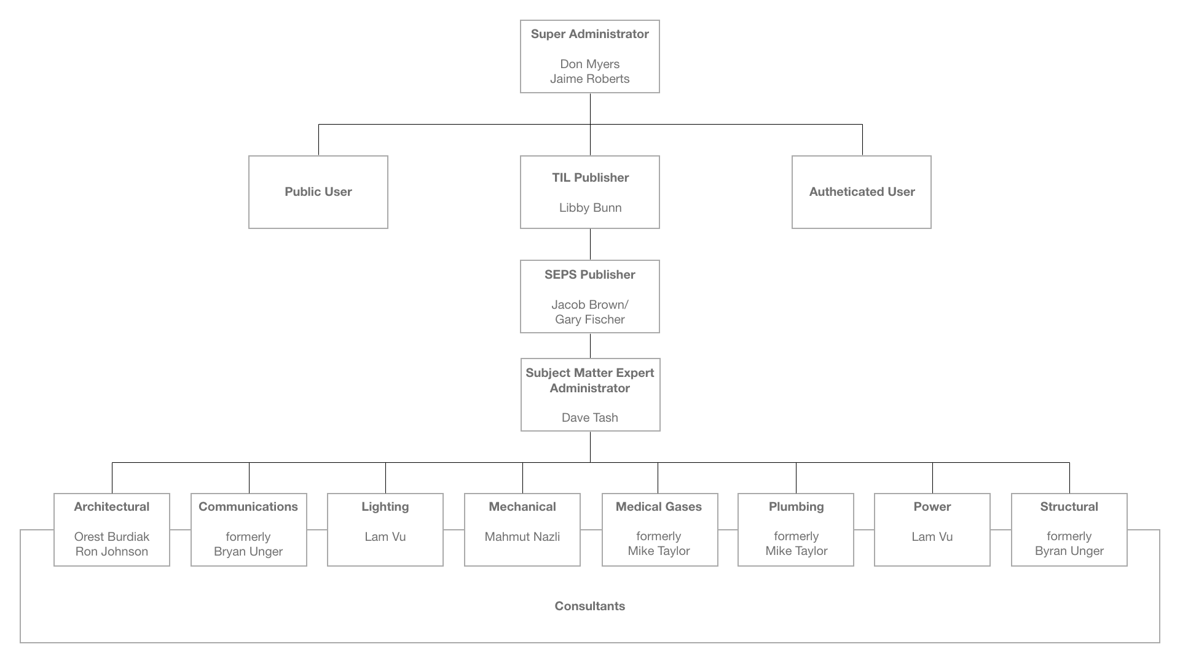
VA|CMS User Role Organization Chart

Slide 7
VA|CMS User Roles
Public
As an anonymous user, I want access to publicly available data OUTSIDE the MAX CAS Authentication boundary, so I can search, browse and discover design and building criteria for the VA Health System.
Acceptance Criteria:
A Public User will be able to access publicly available data OUTSIDE the MAX CAS Authentication boundary.
User DOES NOT need authentication to use site.
The only data public user CAN NOT see that authenticated users can is the following:
Created by
Creation Date
Modified By
Modified Date

Slide 8
VA|CMS User Roles
MAX ID User
As an authenticated user, I want access to view data INSIDE the MAX CAS Authentication boundary, so I can search, browse and discover design and building criteria for the VA Health System. I can also save favorites, save search queries, and bookmark material.
Acceptance Criteria:
User will access all VA-CMS Data behind the MAX CAS Authentication boundary.
User must authenticate identity via MAX.gov login (MAX CAS Authentication)
User can favorite room codes, (etc.) to easily access in the “My Collection” section and open at a later time.
User can save search queries to easily access in the “My Collection” section and relaunch at a later time.
User can bookmark material to easily access in the “My Collection” section and view at a later time.
When SAVED material (FAVORITES, SEARCH QUERIES, and BOOKMARKS) is updated, an email will alert the user of changes
The Alert Bell will display the number of unseen alerts in the applications navigation.

Slide 9
VA|CMS User Roles
Consultant
As an authenticated user, I want access to view data INSIDE the MAX CAS Authentication boundary, so I can search, browse and discover design and building criteria for the VA Health System. I can save favorites, save search queries, and bookmark material. I can also provide additions and updates to the databases to be reviewed and approved by Subject Matter Experts.
Acceptance Criteria:
User will access all VA-CMS Data behind the MAX CAS Authentication boundary.
User must authenticate identity via MAX.gov login (MAX CAS Authentication)
User can favorite room codes, (etc.) to easily access in the “My Collection” section and open at a later time.
User can save search queries to easily access in the “My Collection” section and relaunch at a later time.
User can bookmark material to easily access in the “My Collection” section and view at a later time.
When SAVED material (FAVORITES, SEARCH QUERIES, and BOOKMARKS) is updated, an email will alert the user of changes
The Alert Bell will display the number of unseen alerts in the applications navigation.
User must be able to add and edit Room Criteria Data
User must be able to add and edit Planning Criteria Data
User must be able to add and edit Facilities Criteria Data

Slide 10
VA|CMS User Roles
Subject Matter Expert
As an authenticated user, I want access to view data INSIDE the MAX CAS Authentication boundary, so I can search, browse and discover design and building criteria for the VA Health System. I can save favorites, save search queries, and bookmark material. I can provide additions and updates to the databases; and the ability to approve Consultants work.
Acceptance Criteria:
User will access all VA-CMS Data behind the MAX CAS Authentication boundary.
User must authenticate identity via MAX.gov login (MAX CAS Authentication)
User can favorite room codes, (etc.) to easily access in the “My Collection” section and open at a later time.
User can save search queries to easily access in the “My Collection” section and relaunch at a later time.
User can bookmark material to easily access in the “My Collection” section and view at a later time.
When SAVED material (FAVORITES, SEARCH QUERIES, and BOOKMARKS) is updated, an email will alert the user of changes
The Alert Bell will display the number of unseen alerts in the applications navigation.
User must be able to add and edit Room Criteria Data
User must be able to add and edit Planning Criteria Data
User must be able to add and edit Facilities Criteria Data
(MAYBE) User must be able to approve individual subject matter area of expertise.

Slide 11
VA|CMS User Roles
Subject Matter Expert Coordinator
As an authenticated user, I want access to view data INSIDE the MAX CAS Authentication boundary, so I can search, browse and discover design and building criteria for the VA Health System. I can save favorites, save search queries, and bookmark material. I can provide additions and updates to the databases; the ability to approve Consultants work; and the ability to submit approved additions and edits to the SEPS Publisher and the TIL Publishers
Acceptance Criteria:
User will access all VA-CMS Data behind the MAX CAS Authentication boundary.
User must authenticate identity via MAX.gov login (MAX CAS Authentication)
User can favorite room codes, (etc.) to easily access in the “My Collection” section and open at a later time.
User can save search queries to easily access in the “My Collection” section and relaunch at a later time.
User can bookmark material to easily access in the “My Collection” section and view at a later time.
When SAVED material (FAVORITES, SEARCH QUERIES, and BOOKMARKS) is updated, an email will alert the user of changes
The Alert Bell will display the number of unseen alerts in the applications navigation.
User must be able to add and edit Room Criteria Data
User must be able to add and edit Planning Criteria Data
User must be able to add and edit Facilities Criteria Data
User must be able to approve any and all expertise.
User must be able to submit additions and edits to the SEPS Publisher and the TIL Publisher.

Slide 12
VA|CMS User Roles
SEPS Publisher
As an authenticated user, I want access to view data INSIDE the MAX CAS Authentication boundary, so I can search, browse and discover design and building criteria for the VA Health System. I can save favorites, save search queries, and bookmark material. I can provide additions and updates to the databases; I have ability to approve Consultants work; I have ability to submit approved additions and edits to the TIL Publishers; I have the responsibility to coordinate content with SEPS and the Database; and I have the ability to publish data FOUR times a year.
Acceptance Criteria:
User will access all VA-CMS Data behind the MAX CAS Authentication boundary.
User must authenticate identity via MAX.gov login (MAX CAS Authentication)
User can favorite room codes, (etc.) to easily access in the “My Collection” section and open at a later time.
User can save search queries to easily access in the “My Collection” section and relaunch at a later time.
User can bookmark material to easily access in the “My Collection” section and view at a later time.
When SAVED material (FAVORITES, SEARCH QUERIES, and BOOKMARKS) is updated, an email will alert the user of changes
The Alert Bell will display the number of unseen alerts in the applications navigation.
User must be able to add and edit Room Criteria Data
User must be able to add and edit Planning Criteria Data
User must be able to add and edit Facilities Criteria Data
User must be able to approve any and all expertise.
User must be able to submit additions and edits to the TIL Publisher.
User can publish data to the VA|CMS database FOUR times a year

Slide 13
VA|CMS User Roles
TIL Publisher
As an authenticated user, I want access to view data INSIDE the MAX CAS Authentication boundary, so I can search, browse and discover design and building criteria for the VA Health System. I can save favorites, save search queries, and bookmark material. I can provide additions and updates to the databases; I have ability to approve Consultants work; I have ability to submit approved additions and edits to the SME Publishers; I have the ability to publish additions or edits to the VA|CMS Document Library; I have the responsibility to inform the user base of changes to the TIL and VA|CMS Application; and I have the ability to publish data FOUR times a year.
Acceptance Criteria:
User will access all VA-CMS Data behind the MAX CAS Authentication boundary.
User must authenticate identity via MAX.gov login (MAX CAS Authentication)
User can favorite room codes, (etc.) to easily access in the “My Collection” section and open at a later time.
User can save search queries to easily access in the “My Collection” section and relaunch at a later time.
User can bookmark material to easily access in the “My Collection” section and view at a later time.
When SAVED material (FAVORITES, SEARCH QUERIES, and BOOKMARKS) is updated, an email will alert the user of changes
The Alert Bell will display the number of unseen alerts in the applications navigation.
User must be able to add and edit Room Criteria Data
User must be able to add and edit Planning Criteria Data
User must be able to add and edit Facilities Criteria Data
User must be able to approve any and all expertise.
User must be able to submit additions and edits to the SEPS Publisher.
User can publish all documentation to the TIL FOUR times a year but must first have SEPS Publisher sign off.

Slide 14
VA|CMS User Roles
Super Administrator
As an authenticated user, I want access to view data INSIDE the MAX CAS Authentication boundary, so I can search, browse and discover design and building criteria for the VA Health System. I can save favorites, save search queries, and bookmark material. I can provide additions and updates to the databases; I have ability to approve Consultants work; I have ability to submit approved additions and edits to the SME Publisher and TIL Publisher; I have the ability to publish additions or edits to the VA|CMS Document Library; I have the ability to publish data FOUR times a year; and I have the ability to grant access and assign user roles to VA|CMS application.
Acceptance Criteria:
User will access all VA-CMS Data behind the MAX CAS Authentication boundary.
User must authenticate identity via MAX.gov login (MAX CAS Authentication)
User can favorite room codes, (etc.) to easily access in the “My Collection” section and open at a later time.
User can save search queries to easily access in the “My Collection” section and relaunch at a later time.
User can bookmark material to easily access in the “My Collection” section and view at a later time.
When SAVED material (FAVORITES, SEARCH QUERIES, and BOOKMARKS) is updated, an email will alert the user of changes
The Alert Bell will display the number of unseen alerts in the applications navigation.
User must be able to add and edit Room Criteria Data
User must be able to add and edit Planning Criteria Data
User must be able to add and edit Facilities Criteria Data
User must be able to approve any and all expertise.
User must be able to submit additions and edits to the SEPS Publisher.
User can publish all documentation to the TIL FOUR times a year but must first have SEPS Publisher sign off.
User can grant access to any MAX ID holder
User can assign user roles

Slide 15
Wireframes

Slide 16
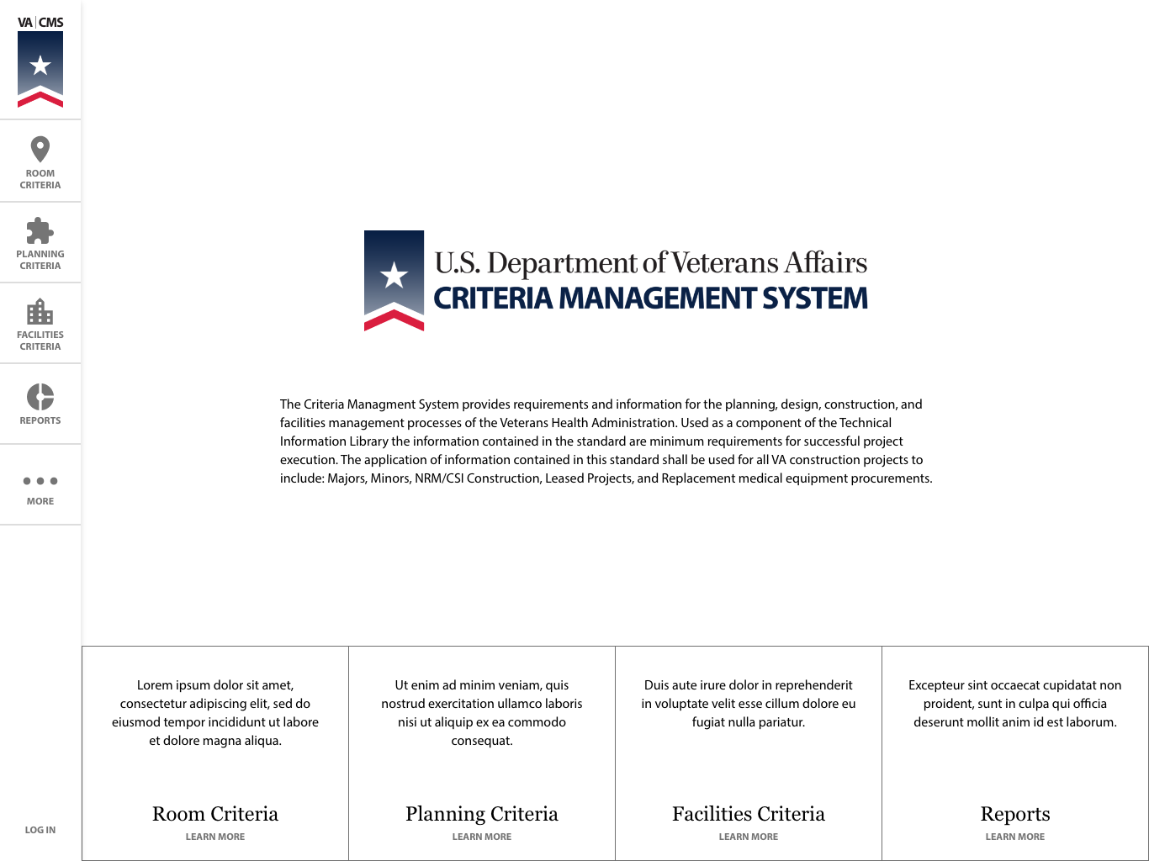
VA|CMS Wireframes
Homepage
(Public)
Collapsed

Slide 17
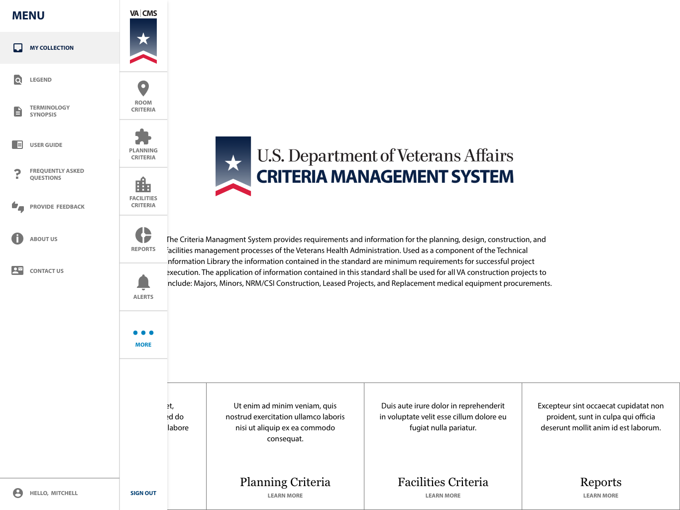
VA|CMS Wireframes
Homepage
(MAX ID)
Expanded

Slide 18
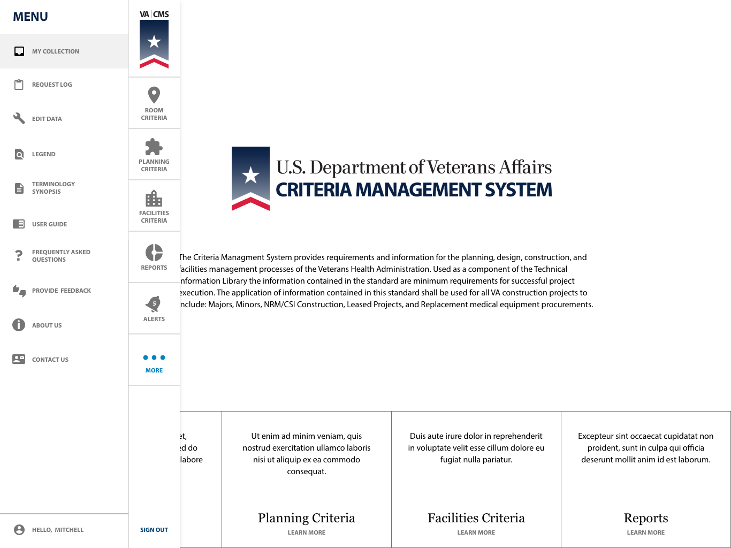
VA|CMS Wireframes
Homepage
(Consultant)
Expanded

Slide 19
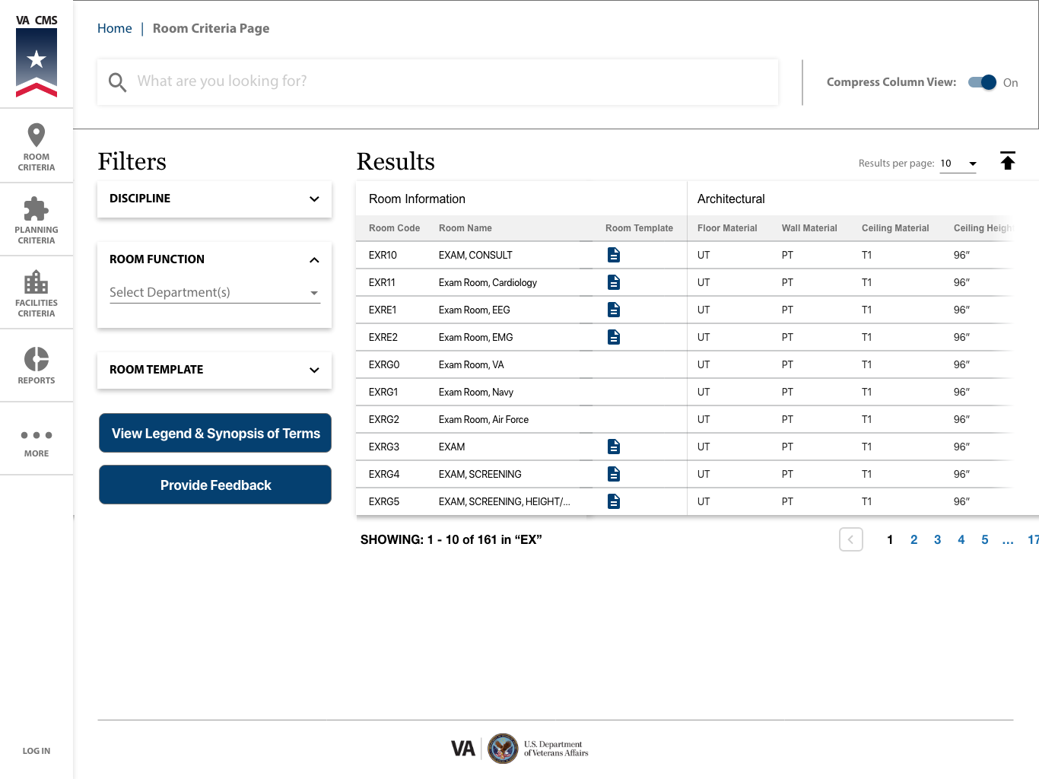
VA|CMS Wireframes
Room Criteria
(Public)
Collapsed

Slide 20
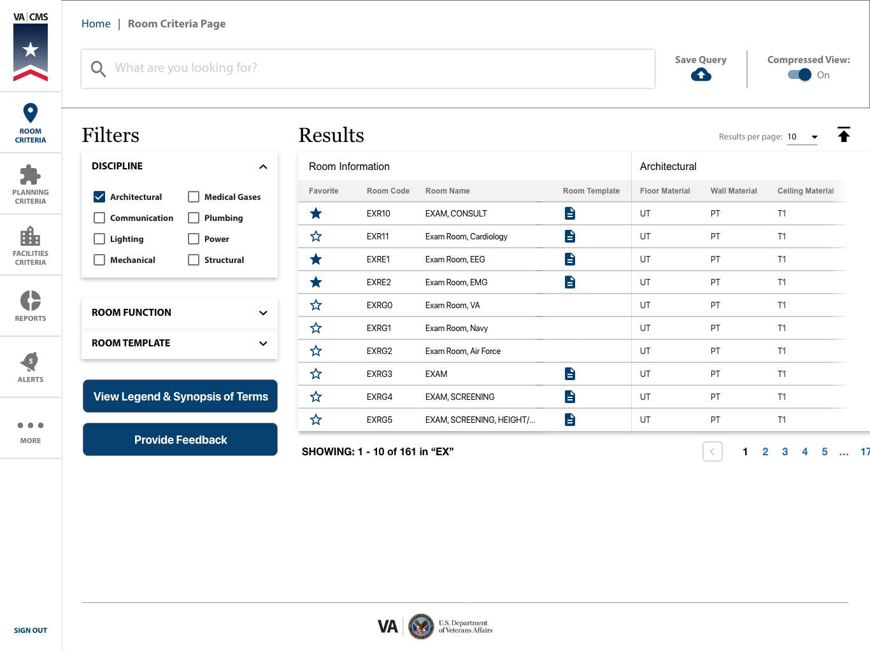
VA|CMS Wireframes
Room Criteria
(Consultant)
Collapsed

